Slide 1
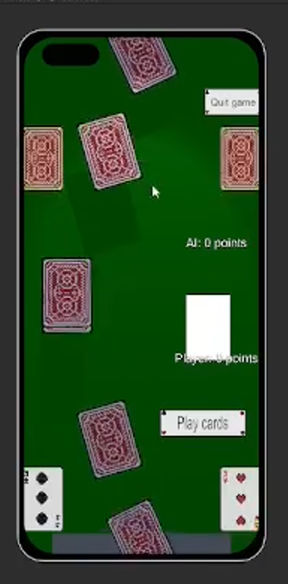
The audio/ visual side
My job was the audio visual side, including:
Animations
Music
Materials
Made example version of main game scene

